Slide 1
Associative Memory: A Spiking Neural Network Robotic Implementation
André Cyr, Frédéric Thériault, Matt Ross, Sylvain Chartier

Slide 2
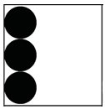
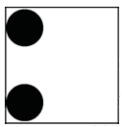
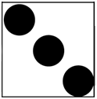
Associative Memory (AM)
Autoassociative (pattern completion):
Input
Output
Input
Output
Heteroassociative:
Input
Output

Slide 3
Associative Memory (AM) Cont.
AM usually refers to complex brain structures [1,2].
Generally modeled at the phenomenological level.
Why model at all?
Cognitive economy for natural or artificial agents [3].
Artificial Neural Network approach
SOM maps, especially for robotic navigation [4,5]

Slide 4
Spiking Neural Network (SNN) Model
Addition of a temporal dimension for encoding information.
Has become another approach to modeling the AM phenomenon [6,7,8].
Current objective: Create a simple embodied bio-inspired mechanism for the AM model, by exploiting the inherent computational and temporal features of a SNN model.
Analytical description of neuronal spike model dynamics can be found at:
http://aifuture.com/res/2018-am/

Slide 5
Spiking Neural Model for AM
Temporal neural features
Asymmetric spike timing
Asymmetric spike-timing dependent plasticity (STDP) learning function [9]:

Slide 6
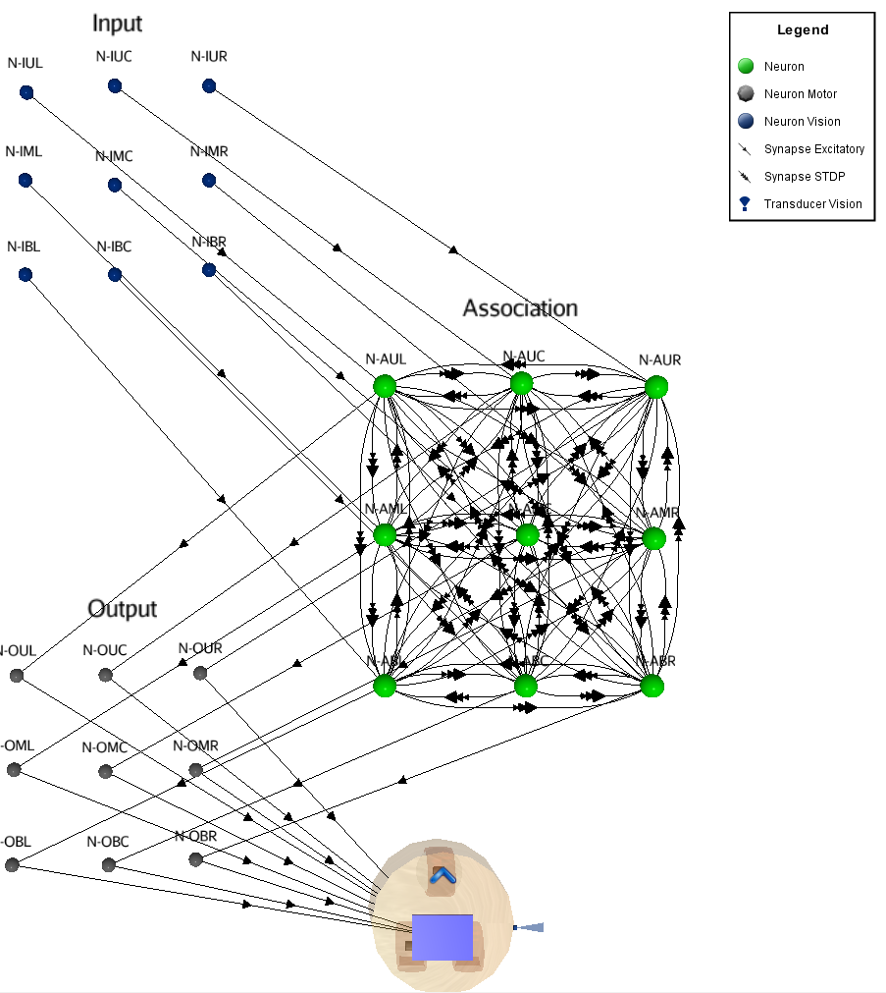
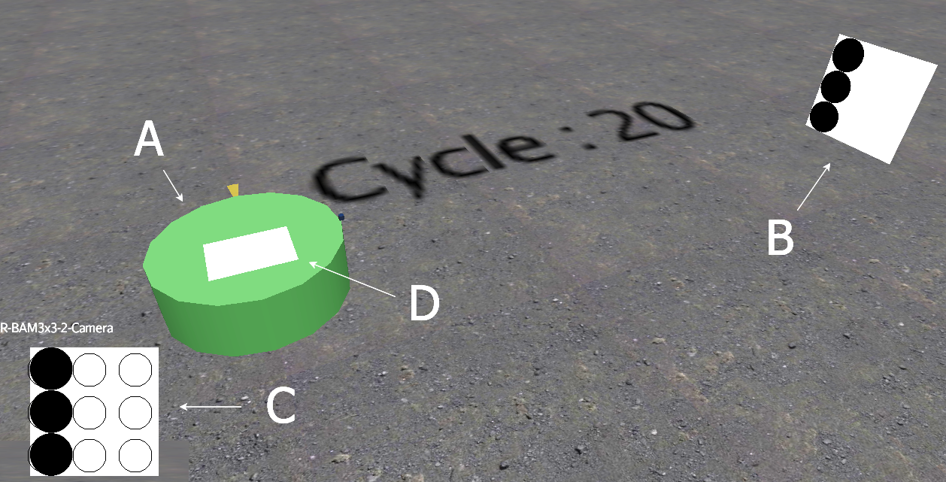
Architecture

Slide 7
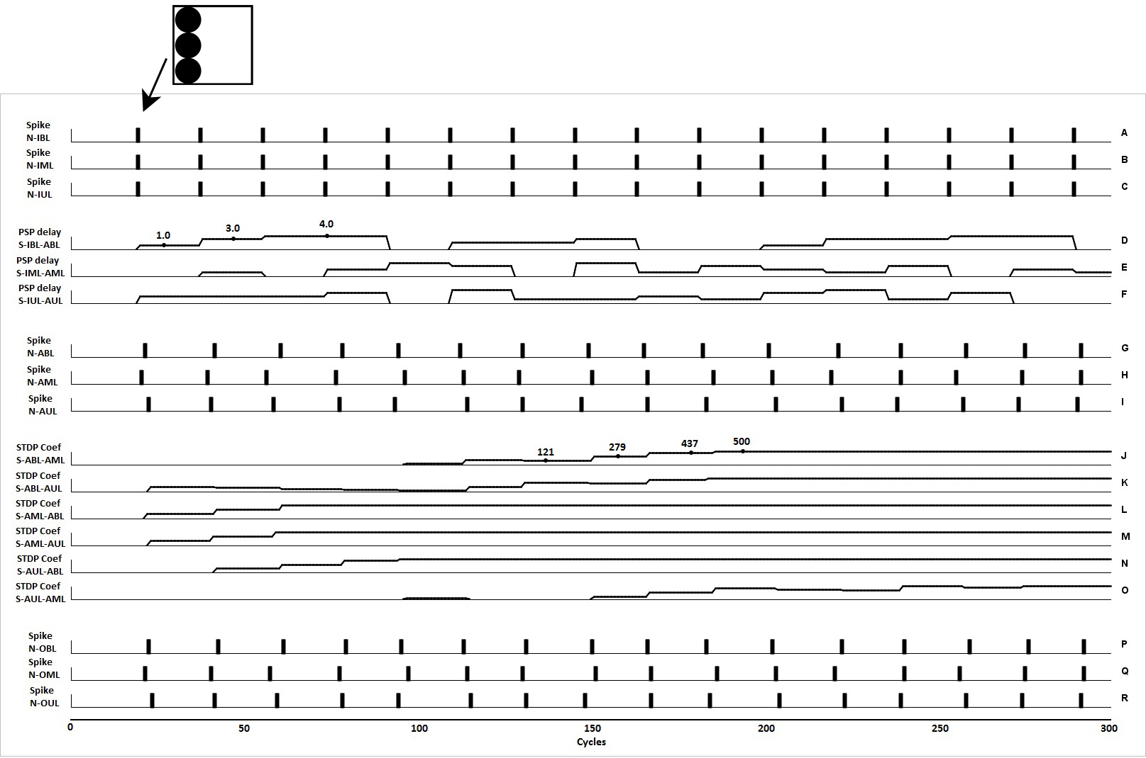
Learning Mechanism
Notes:
graphics A-B-C image caption of the three black dots on the left column generates single spikes of their respective neurons.
graphics D-E-F The randomized spike delays (PSP) between the input and the associative neural layer are produced (graphics G-H-I).
These small PSP delays are enough to be used from the STDP rule to adjust the modulating synaptic factor (graphics J to O: 0-500 percentage scale). Since the synaptic delays are randomized, anti-hebb happens half of the time, but because there was a positive bias favoring the hebb side, eventually results in an increased weight and affects the spiking response of the associative neural units.
graphics P-Q-R output spikes to the LCD device.

Slide 8
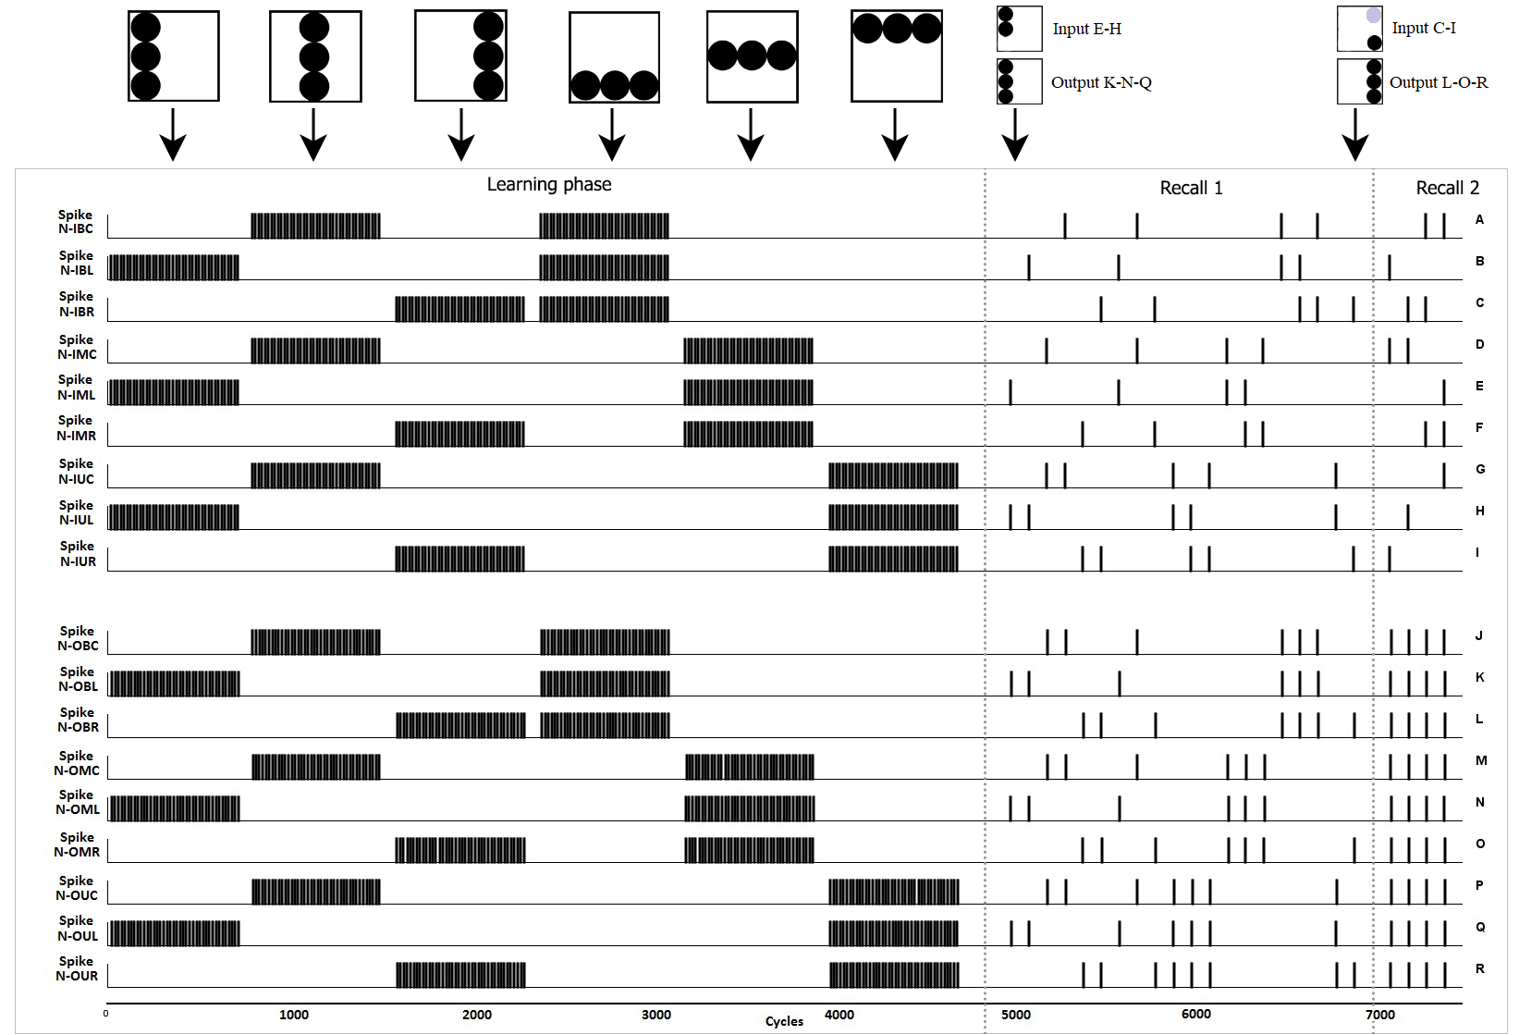
Autoassociative Simulation

Slide 9
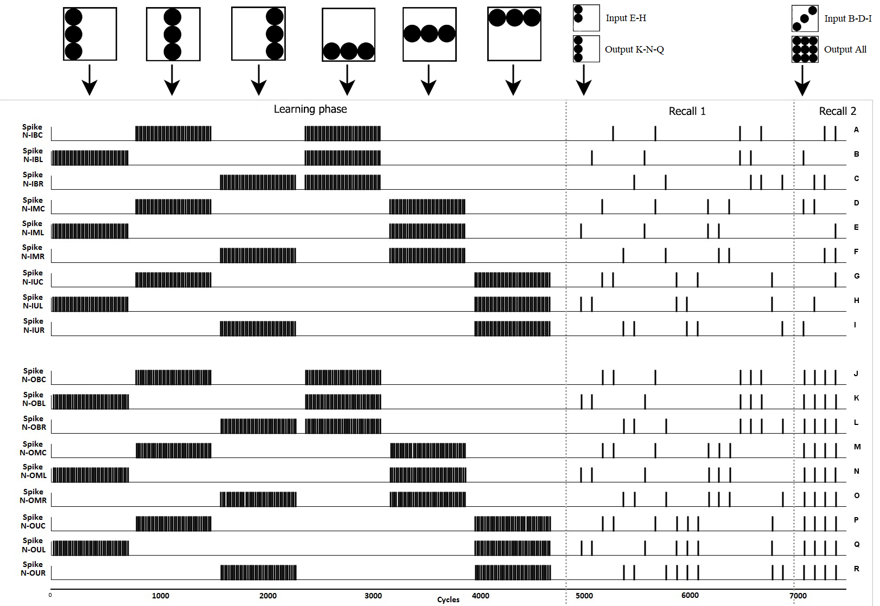
Autoassociative Simulation Cont.

Slide 10
Heteroassociative Simulation

Slide 11
Robotic Implementation
Full video available at:
http://aifuture.com/res/2018-am/

Slide 12
Conclusion
With simple visual tasks and minimalist cellular circuits, it was shown that asymmetric synaptic delays and asymmetric STDP learning are sufficient conditions to achieve pattern-completion and noise tolerance for auto and heteroassociative tasks.

Slide 13
References
Rolls, E.: The mechanisms for pattern completion and pattern separation in the hippocampus. Front. Syst. Neurosci 7(74), 10-3389 (2013)
Smith, D., Wessnitzer, J., Webb, B.: A model of associative learning in the mushroom body. Biological cybernetics 99(2), 89-103 (2008)
Chartier, S., Giguere, G., Langlois, D.: A new bidirectional heteroassociative memory encompassing correlational, competitive and topological properties. Neural Networks 22(5), 568-578 (2009)
Touzet, C.: Modeling and simulation of elementary robot behaviors using associative memories. International Journal of Advanced Robotic Systems 3(2), 165-170(2006)
Tangruamsub, S., Kawewong, A., Tsuboyama, M., Hasegawa, O.: Self-organizingincremental associative memory-based robot navigation. IEIC TRANSACTIONS on Information and Systems 95(10), 2415-2425 (2012)
Gerstner, W., van Hemmen, J.: Associative memory in a network of ‘spiking’ neurons, Network. Computation in Neural Systems, 3:2, 139-164 (1992)
Tan, C., Tang, H., Cheu, E., Hu, J.: A computationally ecient associative memory model of hippocampus ca3 by spiking neurons. In: Neural Networks (IJCNN), The 2013 International Joint Conference on. pp. 1{8. IEEE (2013)
Jimenez-Romero, C., Sousa-Rodrigues, D., Johnson, J.: Designing behaviour in bio-inspired robots using associative topologies of spiking-neural-networks. arXiv preprint arXiv:1509.07035 (2015)
Dan, Y., & Poo, M. (2004). Spike Timing-Dependent Plasticity of Neural Circuits. Neuron, 44(1), 23–30. https://doi.org/10.1016/J.NEURON.2004.09.007

