Slide 1
Bounded Cognitive Resources and Arbitrary Domains
Abdul Rahim Nizamani¹
Jonas Juel²
Ulf Persson²
Claes Strannegård^{1,2}
¹ University of Gothenburg, Sweden
² Chalmers University of Technology, Sweden
AGI 2015
Notes:
Self-introduction

Slide 2
The computer program Alice In Wonderland (AIW)
Notes:
AIW is a computer program to train and use reasoning agents
Alice In Wonderland story as an inspiration

Slide 3
AIW:
Is a system for learning and reasoning in arbitrary symbolic systems
Combines elements of cognitive modeling and classical AI
Enables deductive, abductive and inductive reasoning
Is based on bounded cognitive resources model developed by Strannegård and others
Extends our previous works presented in AGI and CogSci conferences
Notes:
deductive, abductive and inductive: different interpretations for each of these
Only present the computational implementation, not the mathematical model

Slide 4
A. Perceiving
Notes:
How does Alice (an agent in AIW) perceive and represent knowledge?

Slide 5
Domains
Domains are external environments.
A domain is a set of (closed) facts.
A stream is a sequence of facts from a domain.
term ⊢ term
term ⊬ term
Notes:
Fact can be positive or negative
Closed facts are variable free

Slide 6
Terms
Binary trees : nodes labeled with symbols or variables
(2 # 1) # 3
x + y
P ∨ Q
even(2)
Alice # (runs # fast)
Notes:
Symbols: strings of Unicode characters
variables (x, y, z)
(2#1)#3 is the number 213
# is a special label used for concatenation, e.g., words in a sentence
Variables are not just letters, but special types in the program

Slide 7
Rules represent knowledge
Rules rewrite an expression into another expression
Notes:
Production-based systems use rewrite rules (Act-R, Soar)

Slide 8
Types of rules
Deep rule: t ▶ t’
Shallow rule: t ▷ t’
Negative rule: t ▷̸ t’
Deep rule | Shallow rule
1 + (2 + 3) ---------------- 1 + 5 | P ∨ Q ---------- Q
Notes:
t, t’ are terms
Deep rule: t’ can be computed from t in any expression that contains t
Shallow rule: To prove P|Q is true, it is sufficient to prove that Q is true (but not vice versa)
Negative rule ensures that wrong knowledge is not computable.
Pure rules: introducing new variable can lead to infinite search (computational complexity)

Slide 9
Rules are pure
Impure rules | Pure rules
True ▶ True v x False ▶ x x ▶ x + y | True v x ▶ True x + y ▶ y + x
Notes:
Unlike formal logic, rules are pure.
No new variable can appear in the right side

Slide 10
B. Reasoning
Notes:
Cognitive resources

Slide 11
Computations
Computation | Rules
(1 + 5) ∗ (3 + 2)
 | 1 + 5 ▶ 6
6 ∗ (3 + 2)
 | x + y ▶ y + x
6 ∗ (2 + 3)
 | 2 + 3 ▶ 5
6 ∗ 5
 | 6 ∗ 5 ▶ 30
30
Notes:
Computations are modeled with a term-rewriting system
A term is rewritten until a desired state (terminal) is achieved
A* algorithm searches for the minimum-length computations
Computations are independent of domain and symbolic representation

Slide 12
(Bounded) cognitive resources
Working memory capacity
Recognition memory
Span of attention
Long term memory
Notes:
WM: Bounds the length/size of the terms in computations
RM: Remembers recent errors and tries to avoid them (e.g., not reintroducing an axiom that was recently removed from memory)
Span: Maximum length of computations
LTM: Maximum number of remembered axioms/rules

Slide 13
Bounded computations
Max width of a term (e.g., 8)
Max height of computation (e.g., 10)
Finite set of rules (e.g., 200)
Short recognition memory (e.g., 5)
Notes:
Computations using bounded cognitive resources
Bounds are defined arbitrarily and can be changed for particular domains
Bounded computations model the deductive reasoning
LTM is domain-dependant

Slide 14
Unbounded computation
Computation | Rules
(4 # 7) ∗ ((3 # 7) # 9) | i.e., 47*379
((4 # 7) ∗ (3 # 7)) # ((4 # 7) * 9)
((4 # 7) ∗ (3 # 7)) # ((4 * 9) # (7 * 9)) | Term length exceeds 8
((4 # 7) ∗ (3 # 7)) # ((3 # 6) # (6 # 3))
…….. | Computation length exceeds 10
(((1 # 7 ) # 8) # 1) # 3 | e.g., 17813
Notes:
Example of an unbounded computation

Slide 15
Bounded computations in logic
Computation | Rules
(P → Q) ∨ P
 | x → y ▶ ¬x ∨ y
(¬P ∨ Q) ∨ P
 | x ∨ y ▶ y ∨ x
(Q ∨ ¬P) ∨ P
 | (x ∨ y) ∨ z ▶ x ∨ (y ∨ z)
Q ∨ (¬P ∨ P)
 | ¬x ∨ x ▶ T
Q ∨T
 | x ∨ T ▶ T
T

Slide 16
C. Learning
Notes:
Alice learns by acquiring new rules and removing unsound rules

Slide 17
Learning
Learning equates to updating the long term memory from observations/problems
Adding (at most one) rule
Removing (any number of) rules
Notes:
Adding:
Using a selection order to choose the most effective rule
Removing:
When a rule is found to be incorrect, it is removed immediately
When the memory has reached its capacity and a new rule is to be added, an old rule will be removed that has not been very useful

Slide 18
Learning facts
1 + 2 ▶ 3
5 > 10 ▶ False
P ∨ True ▶ True
Notes:
Alice can memorize new facts that she sees!

Slide 19
Learning mixed rules
0 * x ▶ 0
x + 0 ▶ x
True ∨ x ▶ True
x – x ▶ 0
Notes:
Alice makes abstractions of facts
Mixed axioms contain one variable and one constant
Require at least two instances in memory

Slide 20
Learning algebraic rules
x + y ▶ y + x
(x # y) + z ▶ x # (y + z)
(x * y) * z ▶ x * (y * z)
Notes:
Algorithm to count minimum number of instances
Based on number of variables, variable occurrences, etc.

Slide 21
Learning other types of rules
Synonymous words
Larger mixed rules
Inductive function definitions
Notes:
Alice=Bob
Plays=walks
Number sequence extrapolation

Slide 22
Local convergence
x + x ▶ x ∗ x
x + x | x ∗ x
0 + 0 | 0 ∗ 0
0 | 0
x + x | x ∗ x
2 + 2 | 2 ∗ 2
4 | 4
Notes:
Both sides of a rule should compute to the same terminal state
Local: only within the memory of Alice (not in the domain)

Slide 23
Local divergence
x + x ▶ x ∗ x
x + x | x ∗ x
1 + 1 | 1 ∗ 1
2 | 1
Notes:
Both sides of a rule compute to different values
Alice removes locally divergent rules

Slide 24
Theory selection
Several theories can account for the same observation.
AIW uses a simple preference order to select a single rule
Basic knowledge (small facts)
Usefulness
Simplicity (Occam’s razor)
Generality
Notes:
Usefulness for the current problem
Small facts are preferred (e.g., addition and multiplication tables)
Smallest size
Max variable tokens
Min variable types
Lexicographically first
Question: Is there an order of preference suitable for all formal domains?

Slide 25
Redundancy
Non-redundancy (default)
Redundancy
With redundancy | Without redundancy
(0 # x) ▶ (x) (0 + x) ▶ (x) (x + 0) ▶ (x) (x + y) ▶ (y + x) (x # (y # z)) ▶ ((x + y) # z) (x # (y # z)) ▶ ((y + x) # z) (x + (y # z)) ▶ (y # (x + z)) (x + (y # z)) ▶ (y # (z + x)) (x + (y + z)) ▶ (x + (z + y)) (x + (y + z)) ▶ (y + (x + z)) | 0 # x ▶ x 0 + x ▶ x x + y ▶ y + x ((x # y) + z) ▶ (x # (y + z)) ((x + y) + z) ▶ (x + (y + z)) (x # (y # z)) ▶ ((x + y) # z)
Notes:
NR: Alice ensures that no rule in the memory is computable from the rest of the rules. Only necessary rules are learned.
R: Alice collects all rules, which leads to shorter computations but slower learning.

Slide 26
Consistency or conservativeness
Consistency parameter on:
High amount of evidence
High reliability
Learning is slow
Consistency parameter off:
Low evidence
Less reliability
Learning is faster
Notes:
Consistency parameter enables Alice to accept only rules that are thoroughly tested (high amount of evidence)
In the long run, both approaches should lead to a SOUND THEORY
Is that correct?

Slide 27
Consistency or conservativeness
Alice sees: | Alice does: |  | Evidence:
0 ∗ 1 ⊢ 1 | Add | 0 ∗ 1 ▶ 1
0 ∗ 2 ⊢ 2 | Add | 0 ∗ x ▶ x | For x=1,2
0 ∗ 0 ⊢ 0 | Add | 0 ∗ 0 ▶ 0
1 ∗ 1 ⊢ 1 | Add | x ∗ x ▶ x | For x=1,2
2 ∗ 2 ⊢ 4 | Remove | x ∗ x ▶ x
Notes:
What is the necessary and sufficient amount of evidence for a rule?
We can increase the sufficient evidence to 3 instances per variable.
But that is wrong, as other domains (e.g., Boolean numbers) can have only two literals

Slide 28
Examples
Notes:
Only Arithmetic examples (lack of time)

Slide 29
Learning arithmetic (addition)
Alice sees: | Alice does: |  | Evidence:
0 + 1 ⊢ 1 | Add | 0 + 1 ▶ 1
0 + 2 ⊢ 2 | Add | 0 + 2 ▶ 2
0 + 2 ⊢ 2 | Add | 0 + x ▶ x | For x=1,2
1 + 0 ⊢ 1 | Add | 1 + 0 ▶ 1
2 + 0 ⊢ 2 | Add | 2 + 0 ▶ 2
2 + 0 ⊢ 2 | Add | x + 0 ▶ x | For x=1,2
…..
…..
….. | Add | x + y ▶ y + x | For (x,y)=(0,1),(0,2),(1,0),(2,1)

Slide 30
Modulo 2 (even number)
A theory
Facts | Hypotheses
even 0 ▶ True even 1 ▶ False even 2 ▶ True even 3 ▶ False even 4 ▶ True even 5 ▶ False even 6 ▶ True even 7 ▶ False even 8 ▶ True even 9 ▶ False | even (x # y) ▶ even y
A solution
Is 216 even?
even ((2 # 1) # 6)
even 6
True
Notes:
Main hypothesis is a recursive function
Module 5 can be learned completely
Module 3 is learned partially, but can be learned completely as follows

Slide 31
Modulo 3
Given sufficient knowledge, AIW can learn Modulo 3 operation
E.g., it needs to see examples such as:
mod3 (2 + 8) ⊢ False
This tells it that modulo 3 operation is also valid for expressions (not just numbers)
mod3 (x # y) ▶ mod3 (x + y)
Is 216 divisible by 3?
mod3 ((2 # 1) # 6)
mod3 ((2 # 1) + 6)
mod3 (2 # (1 + 6))
mod3 (2 # 7)
mod3 (2 + 7)
mod3 9
True

Slide 32
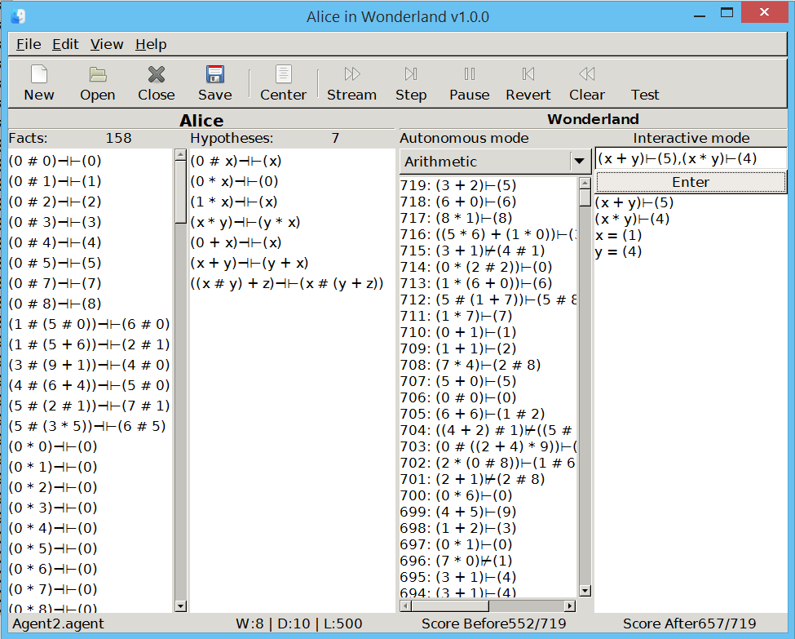
Notes:
Developed in Haskell
Autonomous mode: a “random” stream of problems
Interactive mode: an open problem with multiple statements and variables
Facts: closed rules learned from the environment
Hypothesis: closed or open rules formed by Alice

Slide 33
Results
AIW can learn many domains and is independent of domain-specific semantics
Arithmetic
propositional logic
quantifier-free predicate logic
Grammar checking for simple languages
Classical analogy problems
Previous version was able to learn Haskell expressions (similar to MagicHaskeller)

Slide 34
Conclusion
AIW can learn arbitrary (symbolic) domains from arbitrary (e.g., random) examples
AIW can form inductive rules from concrete instances
AIW can reach human level performance in some domains e.g., arithmetic and propositional logic
The deductive term-rewriting system enables the inductive part
Notes:
Pros and cons of bounded computations and cognitive approach to AI
Cognitive science can guide AI, but should it be the only method to AI?
The program gets very slow after the initial phase.

Slide 35
Thank you for listening!
Schönen Dank
Tack så mycket
谢谢
شكرا
Notes:
123 scripts in Unicode 7.0, many others in the world
Some of them are archaic/historic

